Slide 1
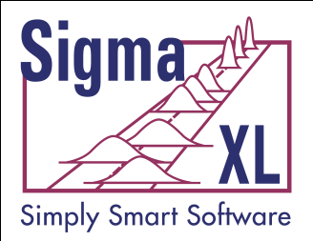
Variation Reduction and Robust Design Using DiscoverSim™
John Noguera
CTO & Co-Founder
SigmaXL, Inc. www.SigmaXL.com
October 12, 2011
Copyright © 2011, SigmaXL, Inc.

Slide 2
Variation Reduction and Robust Design Using DiscoverSim™:
Agenda
Introduction to DiscoverSim
Monte Carlo Simulation
Stochastic Global Optimization
Case Study: Robust Design of Shut-Off Valve Spring Force

Slide 3
Introduction to DiscoverSim
Variation reduction and robust design are a vital part of Design for Six Sigma (DFSS).
While Design of Experiments (DOE) play an important role in DFSS, in order to achieve optimal results, one must also employ the tools of Monte Carlo simulation and optimization.
DiscoverSim is a new, low cost, powerful Excel add-in tool by SigmaXL that will enable these improvements (even with complex, non-linear models).

Slide 4
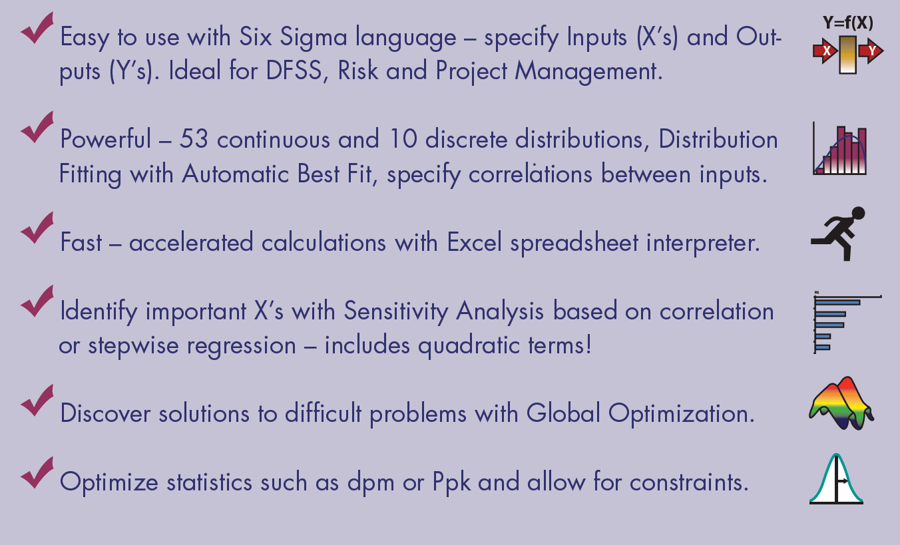
Introduction to DiscoverSim

Slide 5
Introduction to DiscoverSim
Stochastic Global Optimization can be achieved using a hybrid methodology of Dividing Rectangles (DIRECT), Genetic Algorithm, and Sequential Quadratic Programming.
Simulation and optimization speed are realized using DiscoverSim's Excel Formula Interpreter.
  Utilizes Gauss Engine by Aptech.
  Common Object Interface (COI) by Econotron Software to implement an Excel spreadsheet in Gauss Engine.
  The Gauss Random Number Generator is the “KISS+Monster” random number generator developed by George Marsaglia. This algorithm produces random integers between 0 and 2³² – 1 and has a period of 10⁸⁸⁵⁹.
Notes:
References for DIRECT and Hybrid Methods:
Finkel, D. E. (2003). DIRECT Optimization Algorithm User Guide. Technical Report CRSC-TR03-11, Center for Research and Scientific Computation, North Carolina State University, Raleigh, NC.
Finkel, D. E. (2004). DIRECT Version 4.0, Matlab Code, http://www4.ncsu.edu/~ctk/Finkel_Direct/Direct.m
Finkel, D. E. (2005). Global optimization with the DIRECT algorithm. Ph. D. thesis, North Carolina State University.
Hiwa, S., T. Hiroyasu and M. Miki. “Hybrid Optimization Using DIRECT, GA, and SQP for Global Exploration”, Doshisha University, Kyoto, Japan.
Jones, D.R., C.D. Perttunen and B.E. Stuckman (1993), “Lipschitzian Optimization Without the Lipschitz Constant”, Journal Of Optimization Theory And Application: Vol. 79(1), pp. 157 – 181.

Slide 6
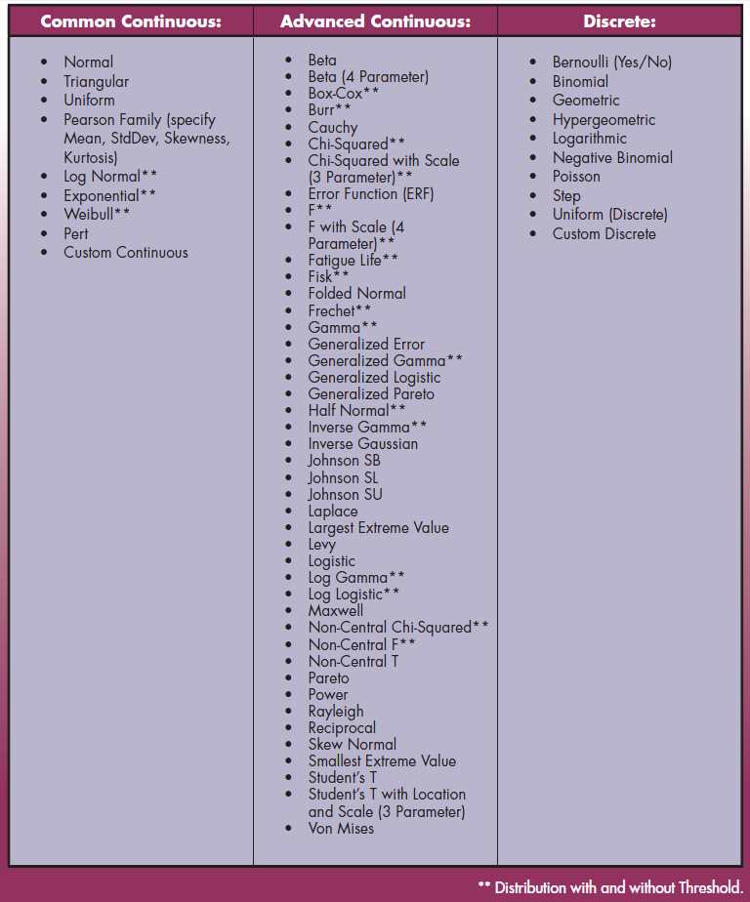
Distributions in DiscoverSim

Slide 7
Monte Carlo Simulation
We start with the Y = f(X) Model, also known as the “Transfer Function”:
The Y = f(X) model should be based on theory, process knowledge, or the prediction formula of a designed experiment or regression analysis.
This prediction equation should be validated prior to use in DiscoverSim: “All models are wrong, some are useful” – George Box.
The results of any Monte Carlo Simulation/Optimization should also be validated with further experimentation or use of prototypes.

Slide 8

Monte Carlo Simulation
After the Y = f(X) relationship has been validated, an important question that then needs to be answered is: “What does the distribution of Y look like when I cannot hold X constant, but have some uncertainty in X?” In other words, “How can I quantify my risk?”.
Monte Carlo simulation comes in to solve the complex problem of dealing with uncertainty by “brute force” using computational power.
The Monte Carlo method was coined in the 1940s by John von Neumann, Stanislaw Ulam and Nicholas Metropolis, while they were working on nuclear weapon projects in the Los Alamos National Laboratory. It was named in homage to Monte Carlo casino, a famous casino, where Ulam's uncle would often gamble away his money.
Notes:
Ref: http://en.wikipedia.org/wiki/Monte_Carlo_method
There are two components to uncertainty: one is the actual process variation, and the second is measurement error or error due to lack of knowledge. The contribution of the latter can be incorporated into a model, but for simplicity we will assume that the measurement error is negligible.

Slide 9
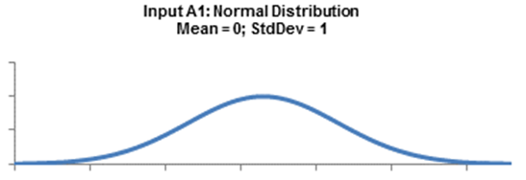
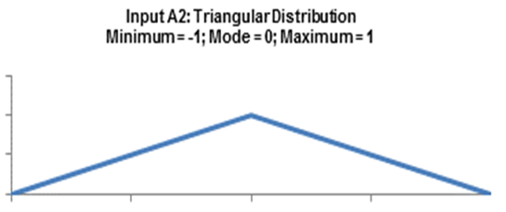
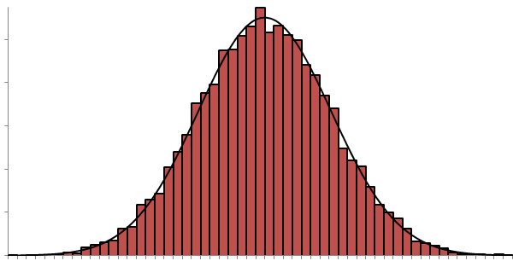
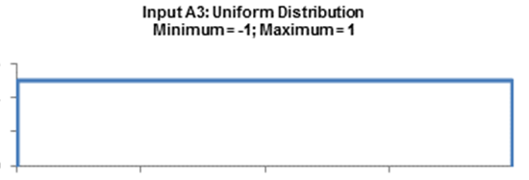
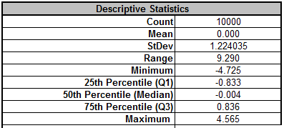
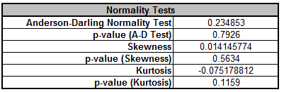
Monte Carlo Simulation
The following diagram illustrates a simple Monte Carlo simulation using DiscoverSim with three different input distributions (X’s also known as “Assumptions”)
Y = A1 + A2 + A3
10,000 Replications
A random draw is performed from each input distribution, Y is calculated, and the process is repeated 10,000 times. The histogram and descriptive statistics show the simulation results.
Notes:
While not shown here, requirements (specification limits) can easily be added to Y to obtain probability of nonconformance.
Notice that even though input distributions A2 and A3 are not normal, the distribution for the total is normal. This is due to the central limit theorem. Of course, this will not always be the case when performing a Monte-Carlo simulation!
The areas of application for Monte-Carlo simulation are very wide, including Design for Six Sigma (DFSS), Tolerance Design, Project Management and Risk Management with common use in Engineering, Finance, Telecommunications and Oil & Gas Exploration.
The following books are recommended for further reading:
Savage, Sam (2009), The Flaw of Averages: Why We Underestimate Risk in the Face of Uncertainty, Hoboken, NJ, Wiley.
Sleeper, Andrew (2006), Design for Six Sigma Statistics: 59 Tools for Diagnosing and Solving Problems in DFSS Initiatives, NY, McGraw-Hill.

Slide 10
Selecting a Distribution
Selecting the correct distribution is a critical step towards building a useful model.
The best choice for a distribution is one based on known theory, for example the use of a Weibull Distribution for reliability modeling.
A common distribution choice is the Normal Distribution, but this assumption should be verified with data that passes a normality test with a minimum sample size of 30; preferably 100.

Slide 11
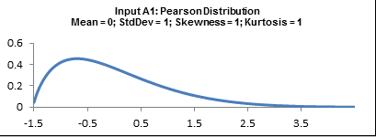
Selecting a Distribution
If data is available and the distribution is not normal, use DiscoverSim’s Distribution Fitting tool to find a best fit distribution.
Alternatively, the Pearson Family Distribution allows you to simply specify Mean, StdDev, Skewness and Kurtosis.

Slide 12
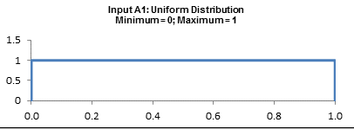
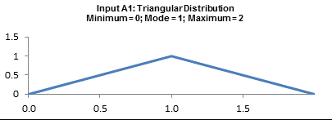
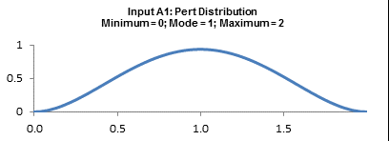
Selecting a Distribution
In the absence of data or theory, commonly used distributions are: Uniform, Triangular and Pert.
Uniform requires a Minimum and Maximum value, and assumes an equal probability over the range. This is commonly used in tolerance design.
Triangular and Pert require a Minimum, Most Likely (Mode) and Maximum. Pert is similar to Triangular, but it adds a “bell shape” and is popular in project management.

Slide 13
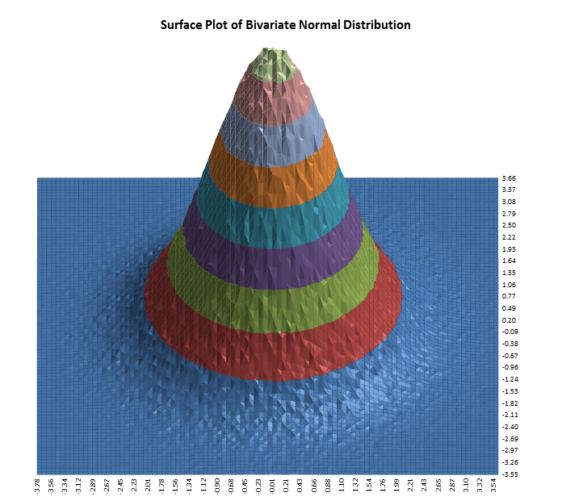
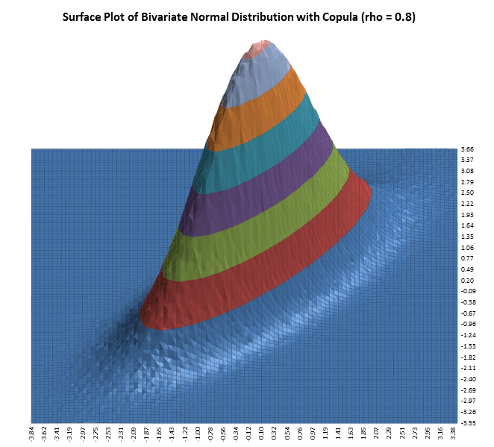
Specifying Correlations
DiscoverSim allows you to specify correlations between any inputs. DiscoverSim utilizes correlation copulas to achieve the desired Spearman Rank correlation values.
The following surface plot illustrates how a correlation copula results in a change in the shape of a bivariate (2 input) normal distribution:

Slide 14
Optimization:
Stochastic Versus Deterministic
Monte-Carlo simulation enables you to quantify risk, whereas stochastic optimization enables you to minimize risk.
Deterministic optimization is a commonly used tool to find a minimum or maximum (e.g., Excel Solver) but it does not take uncertainty into account.
Stochastic optimization will not only find the optimum X settings that result in the best mean Y value, it will also look for a solution that will reduce the standard deviation.
Stochastic optimization looks for a minimum or maximum that is robust to variation in X, thus reducing the transmitted variation in Y. This is referred to as “Robust Parameter Design” in DFSS.

Slide 15
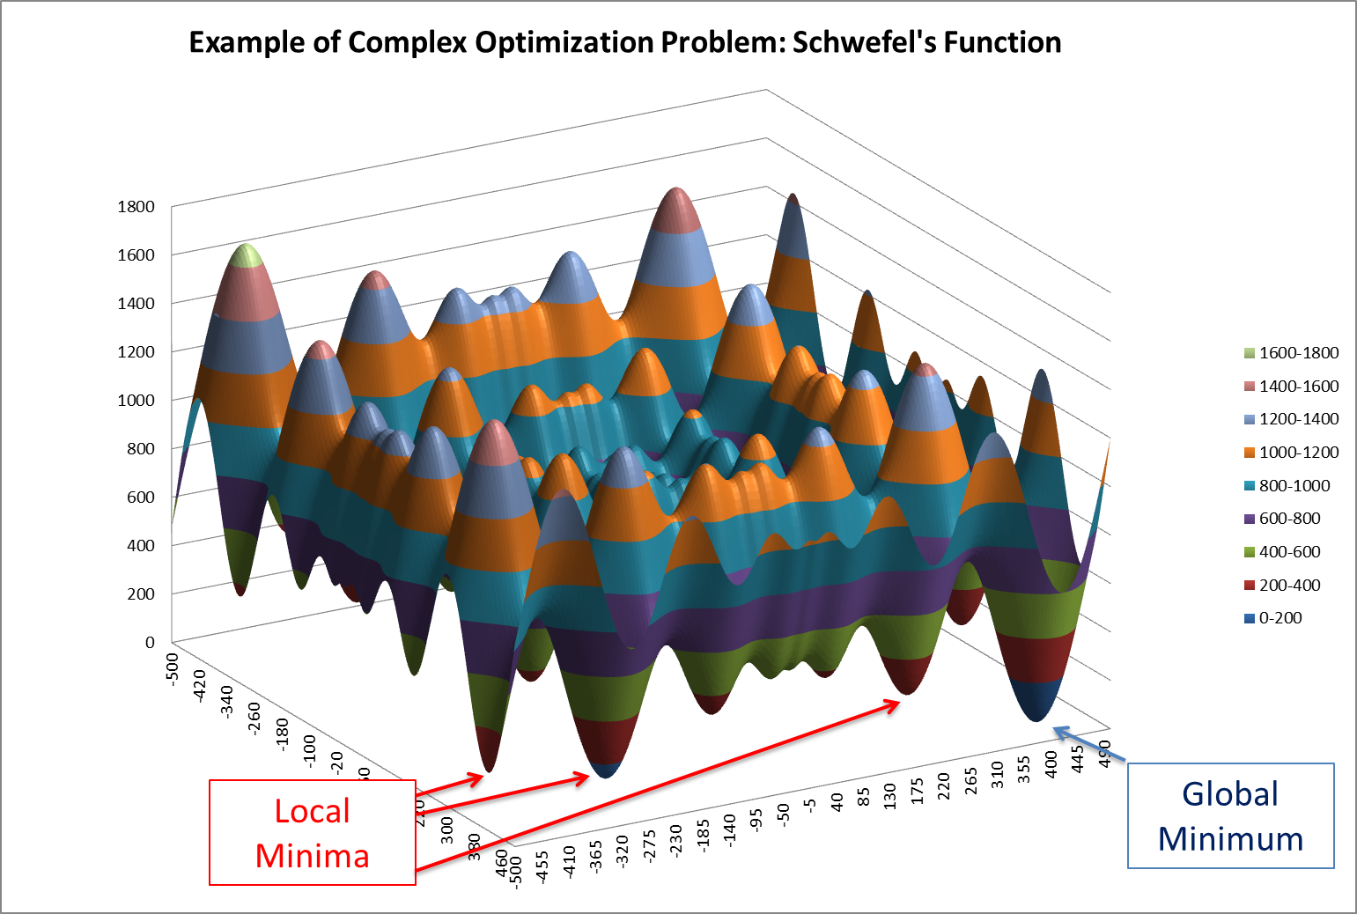
Optimization: Local Versus Global
The following surface plot illustrates a function with local minima and a global minimum:

Slide 16
Optimization: Local Versus Global
Local optimization methods are good at finding local minima, use derivatives of the objective function to find the path of greatest improvement, and have fast convergence. However they require a smooth response so will not work with discontinuous functions.
DiscoverSim uses Sequential Quadratic Programming (SQP) for local optimization.
Notes:
SQP is a very fast and robust algorithm for local nonlinear continuous optimization. The method is based on solving a series of subproblems designed to minimize a quadratic model of the objective subject to a linearization of the constraints, using the Simplex algorithm. If the problem is unconstrained, then the method reduces to Newton's method for finding a point where the gradient of the objective vanishes. For further details see http://en.wikipedia.org/wiki/Sequential_quadratic_programming.

Slide 17
Optimization: Local Versus Global
Global optimization finds the global minimum, and is derivative free, so will work with discontinuous functions. However because of the larger design space, convergence is much slower than that of local optimization.
DiscoverSim uses DIRECT (Dividing Rectangles) and Genetic Algorithm (GA) for global optimization.
A hybrid of the above methodologies is also available starting with DIRECT to do a thorough initial search, followed by GA, and then fine tuning with SQP.
Notes:
DIRECT is a derivative free global optimization method that searches over potentially optimal hypercubes (or hyperrectangles). DIRECT splits the feasible space into ever smaller hypercubes, and continues this process by ascertaining which cubes are potentially optimal. This selection process allows for an efficient evaluation of a high dimensional problem. The feasible space is determined from the lower and upper bounds that the user specifies for each input parameter or input control.
DIRECT is a modification of the Lipschitzian optimization approach that eliminates the need to specify the Lipschitz constant (Jones, 1993; Finkel 2003, 2005). The Lipschitz constant is a weighting parameter, which decides the emphasis on the global and the local search. DIRECT eliminates the use of Lipschitz constant by searching all possible values for the Lipchitz constant thus putting a balanced emphasis on both the global and local search (Porandla). The DiscoverSim algorithm is adapted from Finkel (2004).
GA is a derivative free global optimization method that attempts to find a global optimum by simulating an evolutionary process. Each member of a population (a chromosome) has a set of genes (parameter values). The members breed, and the genes can mutate. Successful chromosomes – i.e., those that are most fit, as evaluated by the optimization process - survive, while the rest die. The parameters associated with the successful genes are returned. See http://en.wikipedia.org/wiki/Genetic_algorithm for further details. On-line interactive tutorials are available at: http://userweb.eng.gla.ac.uk/yun.li/ga_demo/ and http://www.obitko.com/tutorials/genetic-algorithms/.

Slide 18
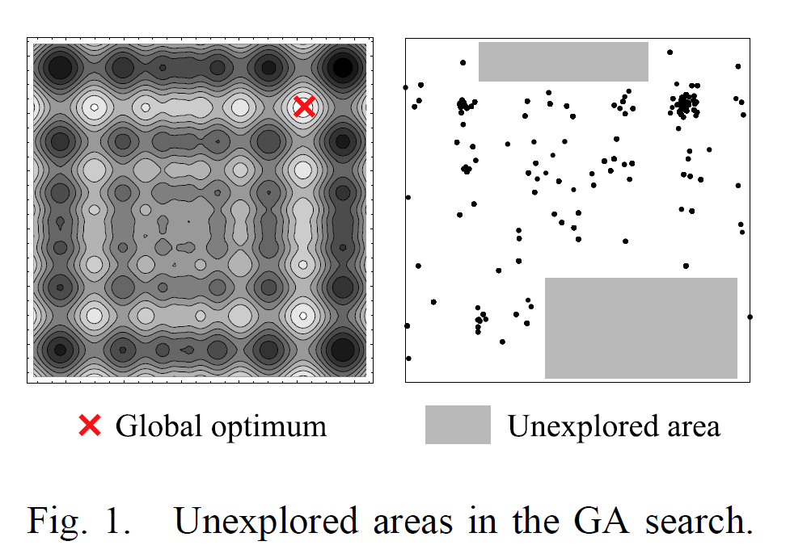
Hiwa, S., T. Hiroyasu and M. Miki. “Hybrid Optimization Using DIRECT, GA, and SQP for Global Exploration”, Doshisha University, Kyoto, Japan.
Notes:
DIRECT is a derivative free global optimization method that searches over potentially optimal hypercubes (or hyperrectangles). DIRECT splits the feasible space into ever smaller hypercubes, and continues this process by ascertaining which cubes are potentially optimal. This selection process allows for an efficient evaluation of a high dimensional problem. The feasible space is determined from the lower and upper bounds that the user specifies for each input parameter or input control.
DIRECT is a modification of the Lipschitzian optimization approach that eliminates the need to specify the Lipschitz constant (Jones, 1993; Finkel 2003, 2005). The Lipschitz constant is a weighting parameter, which decides the emphasis on the global and the local search. DIRECT eliminates the use of Lipschitz constant by searching all possible values for the Lipchitz constant thus putting a balanced emphasis on both the global and local search (Porandla). The DiscoverSim algorithm is adapted from Finkel (2004).
GA is a derivative free global optimization method that attempts to find a global optimum by simulating an evolutionary process. Each member of a population (a chromosome) has a set of genes (parameter values). The members breed, and the genes can mutate. Successful chromosomes – i.e., those that are most fit, as evaluated by the optimization process - survive, while the rest die. The parameters associated with the successful genes are returned. See http://en.wikipedia.org/wiki/Genetic_algorithm for further details. On-line interactive tutorials are available at: http://userweb.eng.gla.ac.uk/yun.li/ga_demo/ and http://www.obitko.com/tutorials/genetic-algorithms/.

Slide 19
DiscoverSim
Components of Optimization
Input Distribution: With the Parameter Optimization option checked, the permissible range for each parameter is specified.
Input Control: The permissible range for the control is specified, and the control, which unlike an input distribution, has no statistical variation.
  Think of this as a control knob like temperature.
  This is also known as a “Decision Variable”.
  An input control can be referenced by a constraint and/or an output function.
  It is possible to have a model that consists solely of controls with no input distributions. (In this case, the optimization is deterministic, so the number of replications, n, should be set to 1.)
  An input control can be continuous or discrete integer.

Slide 20
DiscoverSim
Components of Optimization
Constraint: A constraint can only be applied to an Input Control or Parameter Monitor and cannot reference an Input Distribution or Output Response.
  A constraint cannot be a part of the model equation (i.e., an output cannot reference a constraint).
  Constraints can be simple linear or complex nonlinear.
  Each constraint will contain a function of Input Controls or Parameter Monitors on the Left Hand Side (LHS), and a constant on the Right Hand Side (RHS).

Slide 21
DiscoverSim
Components of Optimization
Parameter Monitor: By specifying an input distribution parameter separately, the parameter can be referenced by a constraint and/or an output function.
  This is useful for dual objective optimization, for example integrated Parameter and Tolerance Design.
  A new output, Cost, can be specified as a function of an input parameter, Standard Deviation.
  Parameter Monitors apply only to the parameters of an input distribution.

Slide 22
DiscoverSim Optimization Metrics
Optimization Goal: | Minimize |  | Maximize
Multiple Output Metric: | Weighted Sum | Deviation from Target | Weighted Sum | Desirability
Statistic: | Mean Median 1st quartile 3rd quartile Minimum Maximum Standard Deviation Skewness Kurtosis Range IQR (75-25) Span (95-5) Actual DPM (defects per million) Calculated DPM (defects per million assuming normal distribution) | Mean | Mean Median 1st quartile 3rd quartile Minimum Maximum Standard Deviation Skewness Kurtosis Range IQR (75-25) Span (95-5) Pp Ppu Ppl Ppk Cpm %Pp (Percentile Pp) %Ppu (Percentile Ppu) %Ppl (Percentile Ppl) %Ppk (Percentile Ppk) | Mean

Slide 23
Case Study: Robust New Product Design - Optimizing Shutoff Valve Spring Force
This is an example of DiscoverSim stochastic optimization for robust new product design, adapted from:
Sleeper, Andrew (2006), Design for Six Sigma Statistics: 59 Tools for Diagnosing and Solving Problems in DFSS Initiatives, NY, McGraw-Hill, pp. 782-789.
Sleeper, Andrew, “Accelerating Product Development with Simulation and Stochastic Optimization”, http://www.successfulstatistics.com/
This example is used with permission of the author.

Slide 24
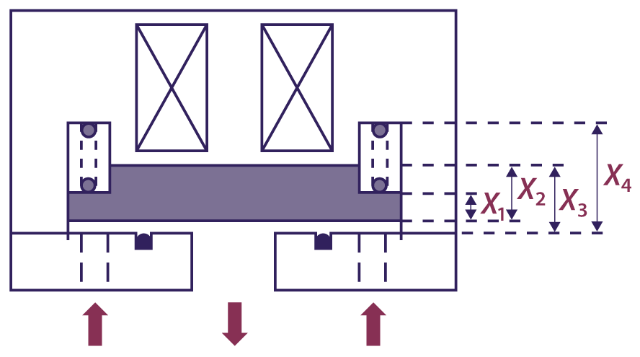
Case Study: Robust New Product Design - Optimizing Shutoff Valve Spring Force
The figure below is a simplified cross-sectional view of a solenoid-operated gas shutoff valve:
The arrows indicate the direction of gas flow.
A solenoid holds the plate (shaded) open when energized. When the solenoid is not energized, the spring pushes the plate down to shut off gas flow.
If the spring force is too high, the valve will not open or stay open. If the spring force is too low, the valve can be opened by the inlet gas pressure.

Slide 25
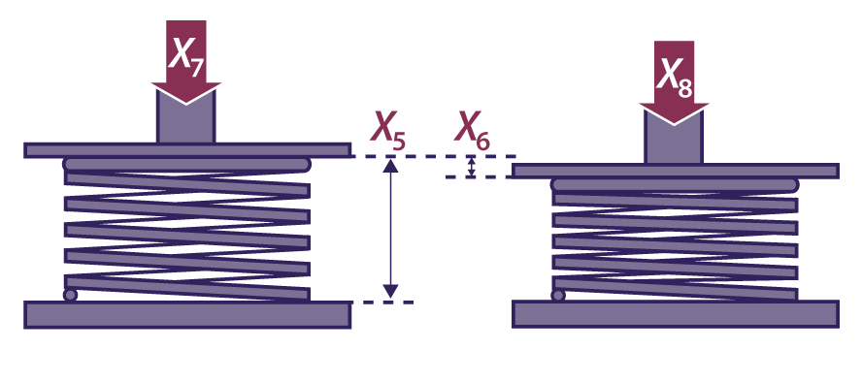
Optimizing Shutoff Valve Spring Force
The method of specifying and testing the spring is shown below:
The spring force requirement is 22 +/- 2 Newtons.
The spring force equation, or Y = f(X) transfer function, is calculated as follows:
Spring Length, L = -X1 + X2 - X3 + X4
Spring Rate, R = (X8 - X7)/X6
Spring Force, Y = X7 + R * (X5 - L)

Slide 26
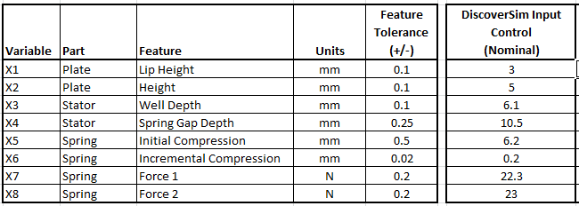
Optimizing Shutoff Valve Spring Force
The shut off valve features, tolerances and nominal settings are given as:

Slide 27
Optimizing Shutoff Valve Spring Force
In this study we will use DiscoverSim to help us answer the following questions:
What is the predicted process capability with these feature tolerances and nominal settings?
What are the key X variables that influence spring force Y? Can we improve the process capability by tightening the tolerance of the important variables? Can this be done economically?
Can we adjust the nominal settings of X to reduce the transmitted variation in Y, thereby making the Spring Force robust to the variation due to feature tolerances? The nominal settings must satisfy constraints such that tolerances do not overlap.
Notes:
See DiscoverSim workbook for Case Study details using the file Shutoff Valve Spring Force.

Slide 28
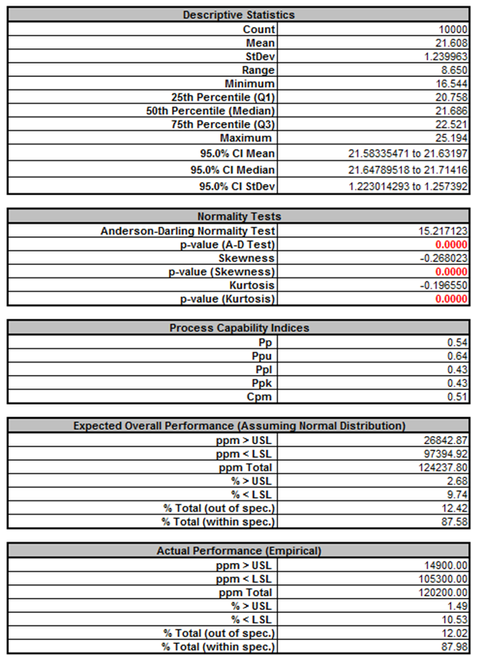
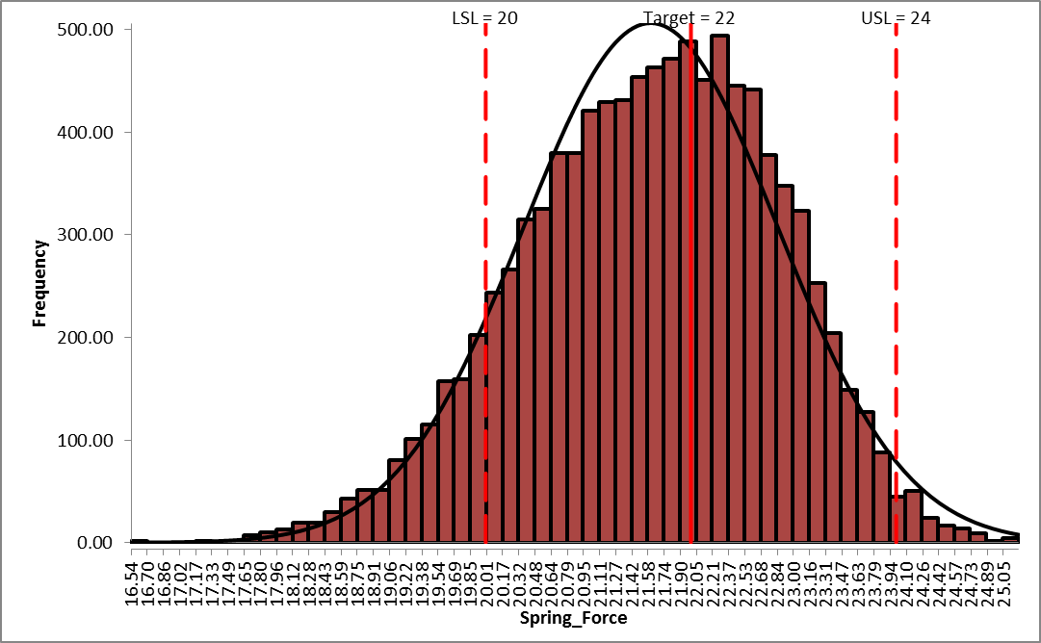
Optimizing Shutoff Valve Spring Force
Initial Simulation Result:
Notes:
See DiscoverSim workbook for Case Study details using the file Shutoff Valve Spring Force.

Slide 29
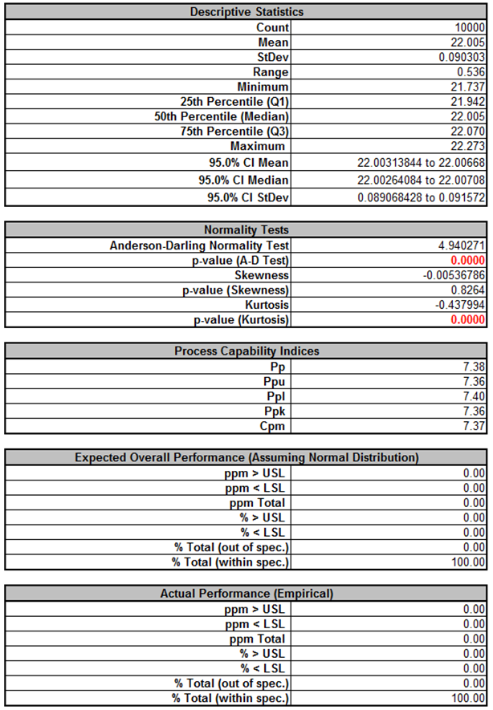
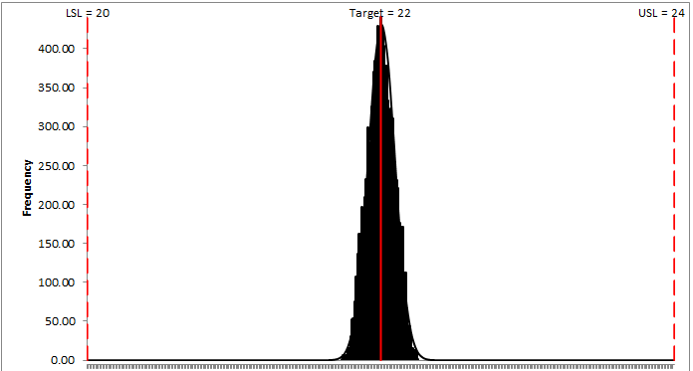
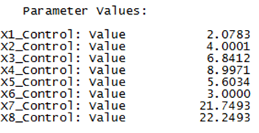
Optimizing Shutoff Valve Spring Force
Final Simulation Result!
Notes:
See DiscoverSim workbook for Case Study details using the file Shutoff Valve Spring Force.

Slide 30
Optimizing Shutoff Valve Spring Force
In summary, DiscoverSim was used to dramatically improve the Spring Force performance as follows:
  Mean centered from 21.6 to 22.0
  Standard Deviation reduced from 1.24 to 0.09, more than a ten-fold reduction!
  Ppk increased from 0.43 to 7.36!
  Actual % Total (out of spec) reduced from 12.4% to 0%!
Notes:
See DiscoverSim workbook for Case Study details using the file Shutoff Valve Spring Force.

Slide 31
Optimizing Shutoff Valve Spring Force
The benefits do not stop here. Since the design is now so robust, we can review the input tolerances to see if there is a cost saving opportunity by widening the feature tolerances, and re-running the simulation to study the impact.
Finally the results predicted here should be validated with physical prototypes before proceeding to finalize the design parameters. Remember “All models are wrong, some are useful!” George Box.
Notes:
See DiscoverSim workbook for Case Study details using the file Shutoff Valve Spring Force.

Slide 32
Recommended Reading
Savage, Sam (2009), The Flaw of Averages: Why We Underestimate Risk in the Face of Uncertainty, Hoboken, NJ, Wiley.
Sleeper, Andrew (2006), Design for Six Sigma Statistics: 59 Tools for Diagnosing and Solving Problems in DFSS Initiatives, NY, McGraw-Hill.

Slide 33
Variation Reduction and Robust Design Using DiscoverSim™
Questions?

